Slide 1
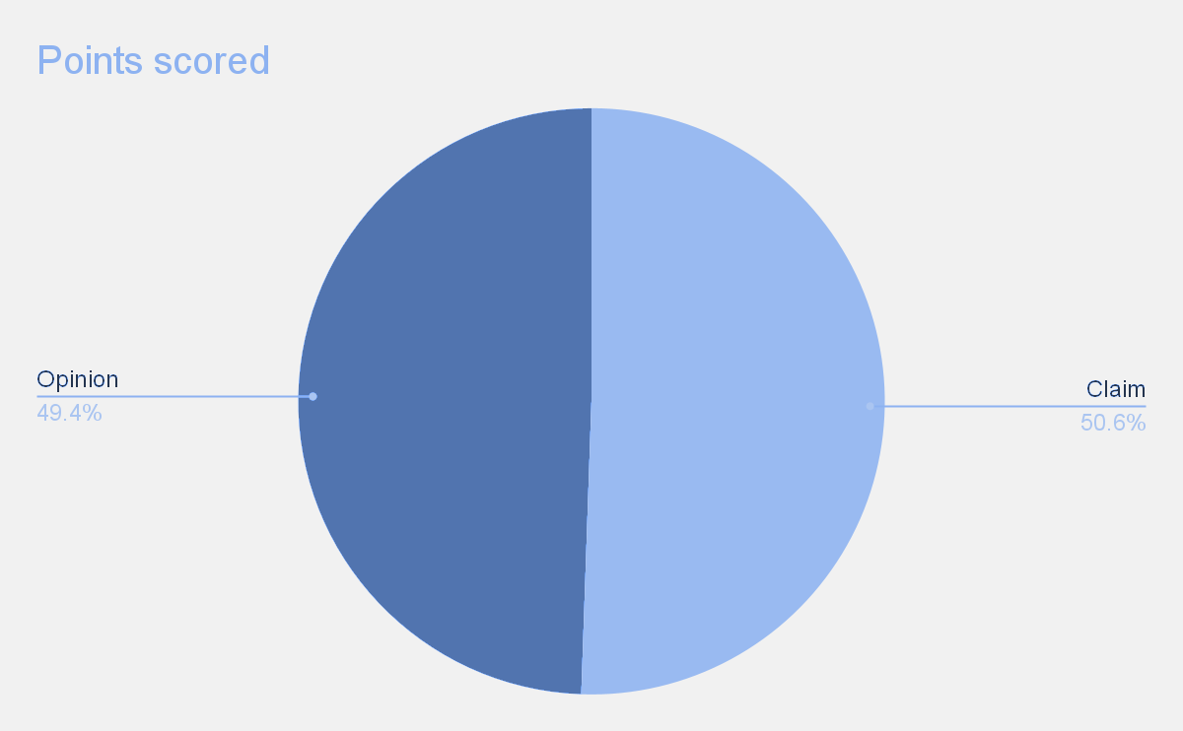
Executive Summary
TikTok Claims Classification Project
TiKTok data team need a predictive model that can determine whether a video contains a claim or offers an opinion to reduce the effort and time taken to categorize videos manually. The data team need to prepare the dataset for EDA.
Preliminary investigation of the claims classification dataset with the aim of learning important relationships between variables is done.
Given the ask for a classification of user claims, the data team looked at the counts of claims and opinions in order to understand the count of each type of video content.
There is a near equal balance of opinions versus claims. With this understanding, we can proceed with our future analysis knowing that there is a fairly balanced amount of claims and opinions for the videos included within this dataset.
Data is analyzed and new columns are added which will be helpful in the next stages. Relation between columns are identified and average of video engagements are observed for different categories.
Image Alt-Text Here

